Slide 1
STATEMENT
Selenium
Ajin Roch
2024

Slide 2


WHY
Core functionality Testing
GUI Testing
DB Testing
Usability Testing
Regression Testing
Sanity Testing
Cross Browser Testing
E2E Testing
Business Process Testing
Jason Huggins

Slide 3






Browser&Navigation
Browser | Navigation |Locator

Slide 4




Web-elements
Web-Elements

Slide 5




TestNG
TestNG

Slide 6




Testing Frameworks
Testing Frameworks

Slide 7



Extend Report & Log4j
Extend Reports & Log4j

Slide 8
1

Slide 9
1
Browser commands
Get Commands
Get Title Command
Get Current URL
Get Page Source Command
Close Command
Quit Command

Slide 10
2

Slide 11
2
Navigation Commands
Navigate().to
Navigate().forward()
Navigate().back()
Navigate().refresh()

Slide 12
3

Slide 13
3
Locator
Driver.findElement(By.id(“small-searchterms”));
Driver.findElement(By.name(“small-searchterms”));
Driver.findElement(By.tagname(“small-searchterms”));
Driver.findElement(By.linkText(“small-searchterms”));
Driver.findElement(By.partialLinktext(“small-searchterms”));

Slide 14
4

Slide 15
4
Xpath
TYPES
Absolute Path
/html/body/div[2]/div[1]/div/h4[1]/b/html[1]/body[1]/div[2]/div[1]/div[1]/h4[1]/b[1]
Relative Path
The//div[@class='featured-box cloumnsize1']//h4[1]//b[1]
re are few axes methods commonly used in Selenium Webdriverlike child, parent, ancestor, sibling, preceding, self, etc.
Methods of Xpath: contains,Starts-with,text(),axes
Xpath=//tagname[@Attribute=‘value’]

Slide 16
1

Slide 17
1
Form WebElements
Input box---→ driver.findElement(By.id(“U_id”));
Checkbox-→ driver.findElement(By.Xpath(“//input[@type=‘checkbox’]”)).click();
Buttons ----→ click and submit options available
DropDown -------→ Select dropdownField=new Select(driver.findElement(By.id(“”dropdown)));
Options available----→ selectByIndex(5);,Selectbyvalue(“Database”),SelectbyVisibleText();
WindowHandling --→ windowhandle(),set,switch to, action
FrameHandling --→ driver.findElements(By.tagName(“iframe”)).size();
Ways to Handle Iframe -→ driver.switchto().frame(0),switchto.frame(“id of the element”),frame(“webLement”)
Alert handling--→ switchTo().alert().dismiss(),accept(),gettext(),sendKeys()

Slide 18
2

Slide 19
2
Mouse & Keyboard Actions
clickAndHold()-----(Use with Actions)
contextClick()
doubleClick()
dragAndDrop(source,target)
dragAndDrop(source,x-offset,y-offset)
KeyDown(modifier_key)
keyUp(modifier key)
moveByOffset(x-offset,y-offset)
moveToElement(toElement)
Release()

Slide 20
3

Slide 21
3
Table and calendar
Get the XPath of Calendar.
Navigate to the desired Year and Month by comparing the current WebElement value with your expected.
You can use Text values of Year and Month after you reach Calendar element.
Take all td elements in a List for that Year and Month.
Loop through the element and click when your expected date matches with the element in the List.
You might have to apply your logic for specific requirements but this logic to get dates will always work.

Slide 22
4

Slide 23
4
Java script and Synchronized
Unconditional wait:
Thread.sleep();
Conditional wait:
Implicit wait
Tells web driver to wait before throwing “No such Element Esception”
Syntax:---driver.manage().timesout().implicitlyWait(10.TimeUnit.Seconds);
Explicit wait
Wait for certain conditions throw “ElementNotVisibleException”
Method---WebDriverWait
Fluent wait
Method----FluentWait<Webdriver>

Slide 24
1

Slide 25
1
TestNG-Annotations
@Test----Part of our Test
@BeforeMethod----will be executed before each @Test
@AfterMethod---After execution of @Test method
@BeforeClass---will be executed before first @Test method and once only per class.
@AfterClass---Same like @BeforTest but will occur after @Test.
@BeforeTest---will be executed before any @Test method, which are in <test> tag in testing.xml file
@AfterTest---Same like @BeforeTest but after @Test method
@BeforeSuite---will run before all suites from test.
@AfterSuite---will start running when execution of all tests executed from current test suites.

Slide 26
2

Slide 27
2
Attributes of @Test
@Test(description)
@Test(dependsOnMethod={method1,method2})
@Test(priority=1)
Hints: Default priority=0,max=5000,min=-5000,Run seq.=Alphabetical order.
@Test(enabled=true)---we shall skip any if needed
@Test(groups={“GroupName”})
@Test(timeout=500)---To Avoid failures in test cases.
Advantage of TestNG.xml file
Parallel execution, prioritization, @parameters—Parametrization oi Test cases.
Data-driven test using @DataProvider

Slide 28
3

Slide 29
3
@DataProvider
Create Test | Create Method
@Test(dataProvider=“LoginData”) Public void dataProviderTest(String username,String password){ System.out.println(“Test started”); System.out.println(username); System.out.println(password); | @DataProvider—(returns array of Objects) @DataProvider(name=“LoginData”) public static Object[][] loginData(){ Return new Object[][]{{“user1”,”pass1”},{“user2”,”pass2”}}}

Slide 30
4

Slide 31
4
TestNG Report & screenshot
TestNG-Execution | TestNG-Report-Generation | Screenshot(SS)
1. TestNg.xml classes will be executed | 3 Methods: | 2 Important methods in Screenshot
2. Example: <suite name=“”> <test name=“”> <classes> <class name=“com.first.example.demoone”> </class> </classes> </test> </suite> | emailable-report.html index.html Reporter class Reporter class generally stores logs, its method are Reporter.log(String s) Reporter.log(String s,Boo s) Reporter.log(Str s,int level) Reporter.log(str s,int lvl,Bo ) | TakesScreenshot---To take SS. getScreenshotAs---To save SS. Example: TakesScreenshot ss=(TakesScreenshot)driver; File source=ss.getScreenShotAs(OutputType.File); FileUtils.CopyFile(source,new File)

Slide 32
1

Slide 33
1
Application.properties
Data stored in the file as key value pairs | Reading the data from Properties file | Using Property file in scripts read and send data
MobileTesting=//a[text()=‘MOBILE TESTING’] EmailTextBOx=field-email SignUpButton=Field-name | Properties obj=new Properties(); FileInputStream objFile=new FileInputStream(System.getProperty(“user.dir”)+”\\application,properties”); obj.load(objFile); String MobileTesting=obj.getProperty(“MobileTesting); | driver.findElement(By.xpath(obj.getProperty(“MobileTesting”))).click(); Driver.findElement(By.id(obj.getProperty(“EmailTextBOX”))).senKeys(“testing@gmail.com”);

Slide 34
2

Slide 35
2
Excel Integration
Apache POI | Excel handling using Apache POI | Reading the excel sheet cell wise
Selenium supports only .csv To read xls and xlsx file we need to download Apache POI and Configure in Eclipse. Add all jar files in ooxml-lib folder. Create a excel sheet named Data.xlsx file, with sheet name as “Input” | FileInputStream fis=new FileInputStream(“D:\\Selenium\\Data.xlsx”) Workbook wb=Workbookfactory.create(fis); Sheet sh=wb.getSheet(“Input”); | Row rw=sh.getRow(2); Cell cell=rw.getCell(1); String cellval=cell.getStringCellValue(); System.out.println(cell); System.out.println(cellval); CODE

Slide 37
Public static void writeData(int rownum,int colnum,String val,String path)
throws IOException{
Row=ExcelWorksheet.getRow(rownum);
Cell=Row.getCell(“colnum);
If(cell==null)
{
Cell=Row.createCell(colnum);
Cell.setCellValue(val);
}
Else{
Cell.setCellValue(val);
}
FileOutputStream fout=new FileOutputStream(path);
Excelbook.write(fout);
Fout.flush();
fout.close();
}

Slide 38
3

Slide 39
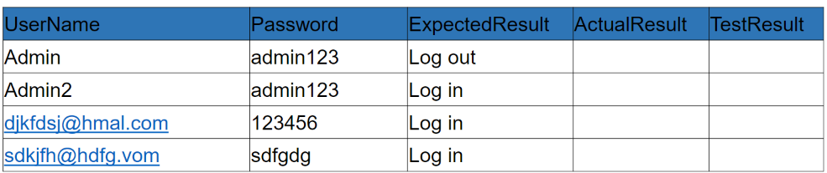
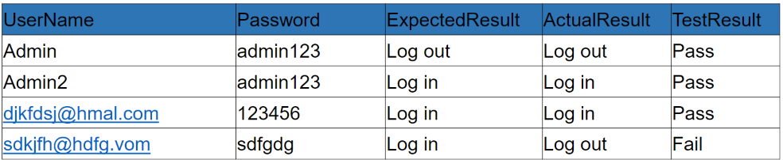
3
Read Data from Excel
Apache POI | Input Data | Output Expected
Apache POI provides have java API that support OOXML(Office Open) XML standard and Microsoft OLE2 standard.

Slide 40
System.out.println( "Hello World!" );
For(int rows=1;rows<=4;rows++){
System.setProperty(“webdriver.edge.driver”,”D:\\edgedriver_win64\\msedgedriver.exe”);
Driver = new Edgedriver();
Driver.get(“www.google.com”);
//All methods are static so you shall use class name to access object.
Excelutilities.setExcelSheet(“D:\\TestData\\Logininfo.xlsx”,”Login”);
//Enter password
Driver.findElement(By.id(“password”)).sendkeys(Excelutilities.readData(rows,1));
//Enter username
String uname=Excelutilities.readData(rows,o);
Driver.findElement(By.id(“Email”)).sendkeys(uname);
//click login
String Expectedvalue=Driver.findElement(By.path(“//input[@value=‘ Login’]”)).click();
String actualValue=driver.findElement(By.partialLinkText(“Log”)).getText();
Excelutilities.writeData(rows,3,actualData,)
If(actualValue.equalsignorecase(ExpectredValue))-→Excelutilities.writeData(rows,4,”PASS”)
}

Slide 41
4

Slide 42
4
Extend Reports & log4j
Extend Reports | log4j
Open source Reporting library Two major classes used ExtentReports class ExtentTest class Based on Boolean flag existing report shall be modified. Jar file shall be added to use that | Exactly give the idea about software performance through log files. It have the following components Logger Appenders Layout These components are defined in log4j.properties file.

Slide 43
1

Slide 44
1
Extend Reports
Extend Report Usage | Why Extend Report | Steps
ExtendReports reports=new ExtendReports(“path to store html file”,true or false); ExtendTest test=reports.startTest( Reports.endTest(); Test.log(logStatus.PASS (or),FAIL (or) SKIP,(or) INFO,”String to be showcased”); | Open source and create graphs,pie charts,screenshots It is configurable on the jenkis server. Multiple Test cases runs within the singke Test suite is tracked with this report. Extend-config.xml for Config | String Exportpath=“path.html”; ExtendHtmlReporter htmlreporter=new ExtendHtmlreporter(Exportpath); ExtendReporters reporter=new ExtendReporters(); Reporter.attachReporter(htmlreporter);

Slide 45
2

Slide 46
2
Extend Report
Test case and Test Step creation | Others | Config in Extend Report
ExtendTest testCase1=reporte.createTest(“”) ExtendTest testStepA1=testCase1.createNode(“A1”); //Logging the status testStepA1.log(Status.PASS,”details”); | //Assigning Author name testCase1.assignAuthor(“Test User one”); //To create Category testCase1.assignCategory(“System Design”); | ExtendHtmlReporter htmlReporter=new ExtendHtmlReporter(“report.html”) HtmlReporter.config().setDocumentTitle() (or) .setPortocol(protocol.HTTPS) (or) setEncoding(“UTF-8”) (or) .setTheme(“Theme.LIGHT”)

Slide 47
3

Slide 48
3
Log4j
Logger Instance(for log levels) | Appenders—(Grabs from logger and store in certain location) | Layout(format in which the log will appear)
ALL---include all in logs ERROR---Error Events that may not stop the application WARN---may not stop the execution, but still cause the problem DEBUG---To get the debug info INFO---gives progress of the application FATAL---Information that may crash the application. | FileAppender----Append the log messages to the file RollingFileAppender---same as FileAppender, but max file size defined and if exceeds will create new file. DailyRollingFileAppender—It creates on daily basis ConsoleAppender—it creates in the console | Pattern layout HTML Layout XML layout Simple Log4j Property file

Slide 49
# Root logger
log4j.rootLogger=INFO, file, stdout
# Direct to a file
log4j.appender.file=org.apache.log4j.RollingFileAppender
log4j.appender.file.File=C:\\Users\\Ajinroch\\main.log
log4j.appender.file.MaxFileSize=5KB
log4j.appender.file.MaxBackupIndex=3
log4j.appender.file.layout=org.apache.log4j.PatternLayout
log4j.appender.file.layout.ConversionPattern=%d{yyyy-MM-dd HH:mm:ss} %-5p %c{1}:%L - %m%n
# Direct to console
log4j.appender.stdout=org.apache.log4j.ConsoleAppender
log4j.appender.stdout.Target=System.out
log4j.appender.stdout.layout=org.apache.log4j.PatternLayout
log4j.appender.stdout.layout.ConversionPattern=%d{yyyy-MM-dd HH:mm:ss} %-5p %c{1}:%L - %m%n

Slide 50
4

Slide 51
4
log4j
Log4j property file configuration
Adding a second Appendar
Format modifiers and Conversion Character

Slide 52
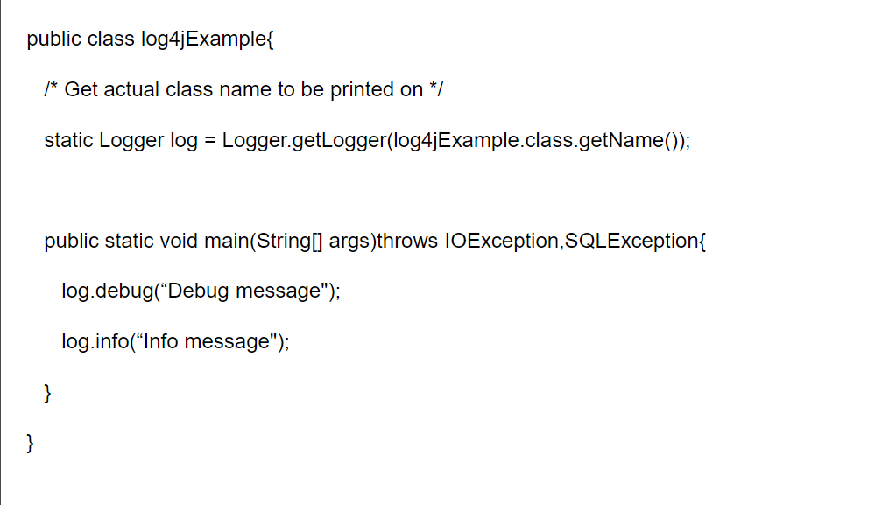

Slide 53
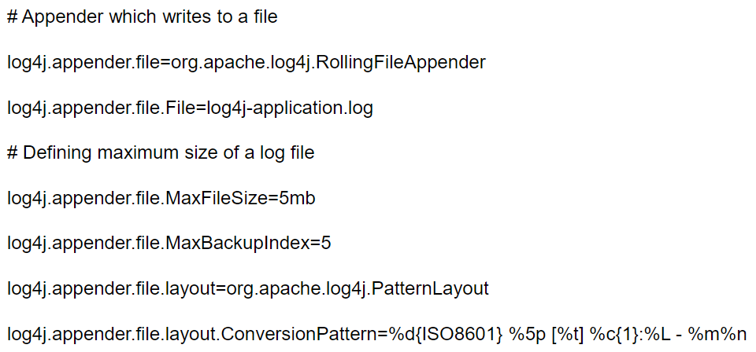
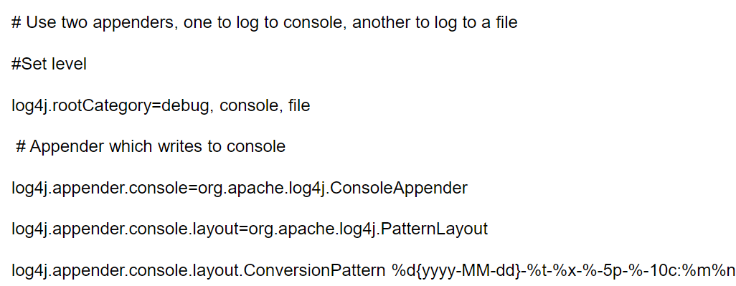

Slide 54
